Slide 1
Visual Listening
Extracting Brand Image Portrayed on Social Media
Neeraj Kumar | Linda Samsinger | Theebana Rajendram | Vincent Rüegge

Slide 2
Agenda
Introduction
Benefits of the Web Application for Marketers
Design of the Deep Learning Model Architecture
From Image Data to Model Deployment on a Web App
Problems and Improvements
How to use Deep Learning for Marketing? | Visual Listening

Slide 3





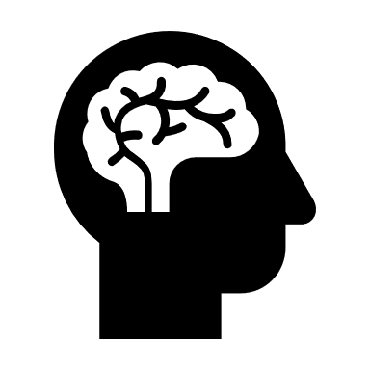
Introduction
Task
Design a Web Application to analyze brand images portrayed on Social Media.
Approach
Develop a Deep Learning Model to classify images according to predefined attributes and deploy the model to the Web Application.
Web Application
Request
Web Application
Response
Model Prediction
Deep Learning Model
Social Media URL of brand
Brand name
Association of brands with attributes
How to use Deep Learning for Marketing? | Visual Listening In

Slide 4
Benefits of the Web Application for Marketer
Consumer Insights
Benchmarking
New Opportunities
Better understand consumer’s brand perception
Brand positioning compared to competitors
Improve firm’s brand image
How to use Deep Learning for Marketing? | Visual Listening In

Slide 5
Description of the Deep Learning Model
Multiclass Image Classification Problem
Classify brand images according to the following 4 attributes:
→ Each attribute corresponds to one class.
Transfer Learning Approach
We use the pre-trained ResNet50 model and add our own last fully connected classifier layer.
Model Prediction
Predict class label for brand images.
Example: Brand «DAR-VIDA»
Fun | Healthy
Glamorous | Rugged
Input: Brand Image
Output: Class Label
How to use Deep Learning for Marketing? | Visual Listening In

Slide 6
From Image Data to Model Deployment on Web App
Labeled
Flickr
Images
Data Preprocessing
…
Train-Test-Validation Split: 80:10:10
Each classifier was trained independently with the corresponding attribute dataset
Train
Validate
Test
Unlabeled
Instagram
Images
Label Classifier Model
Each classifier belongs to an attribute
Model accuracy: 73%
Model Prediction
Web Application
How to use Deep Learning for Marketing? | Visual Listening In

Slide 7
Limitations and Improvements
How to use Deep Learning for Marketing? | Visual Listening In

Slide 8
Neeraj Kumar | Linda Samsinger | Theebana Rajendram | Vincent Rüegge

